Slide 1

On the Origin of e-species
Jonatan Gómez Perdomo
jgomezpe@unal.edu.co
ALIFE Research Group
Universidad Nacional de Colombia
Notes:
1 1 1 1 1

Slide 2
Life
This topic is highly controversial
An organismic state characterized by capacity for metabolism, growth, reaction to stimuli, and reproduction ( Merriam-Webster Definition)
Notes:
2 2 2 2 2

Slide 3
Life: What About?
Mule — cannot self-reproduce; cannot evolve
Virus — cannot self-reproduce; does not have a metabolism
Prion — like a virus; no self-representation but itself
Notes:
3 3 3 3 3

Slide 4
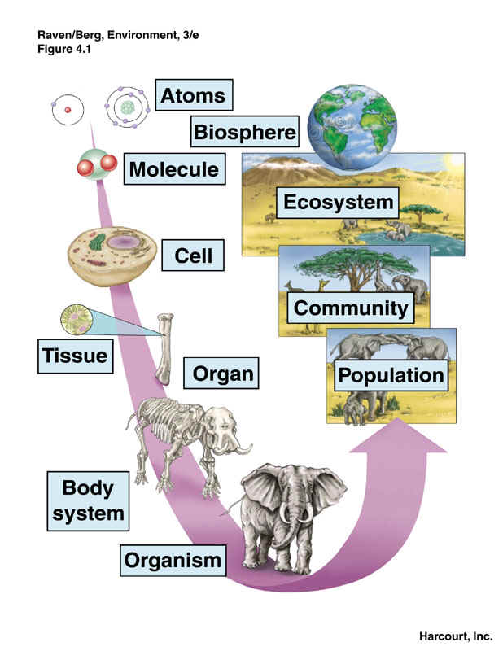
Life: Organization
Notes:
4 4 4 4 4

Slide 5
Life: Characterization
A pattern in space-time
Reproduction - Autopoeisis
Recombining instructions set
Metabolism
Interaction with the Environment
Notes:
5 5 5 5 5

Slide 6
Life: Characterization
Interdependence of parts
Stability under perturbation
Ability to evolve
Homeostasis
Notes:
6 6 6 6 6

Slide 7
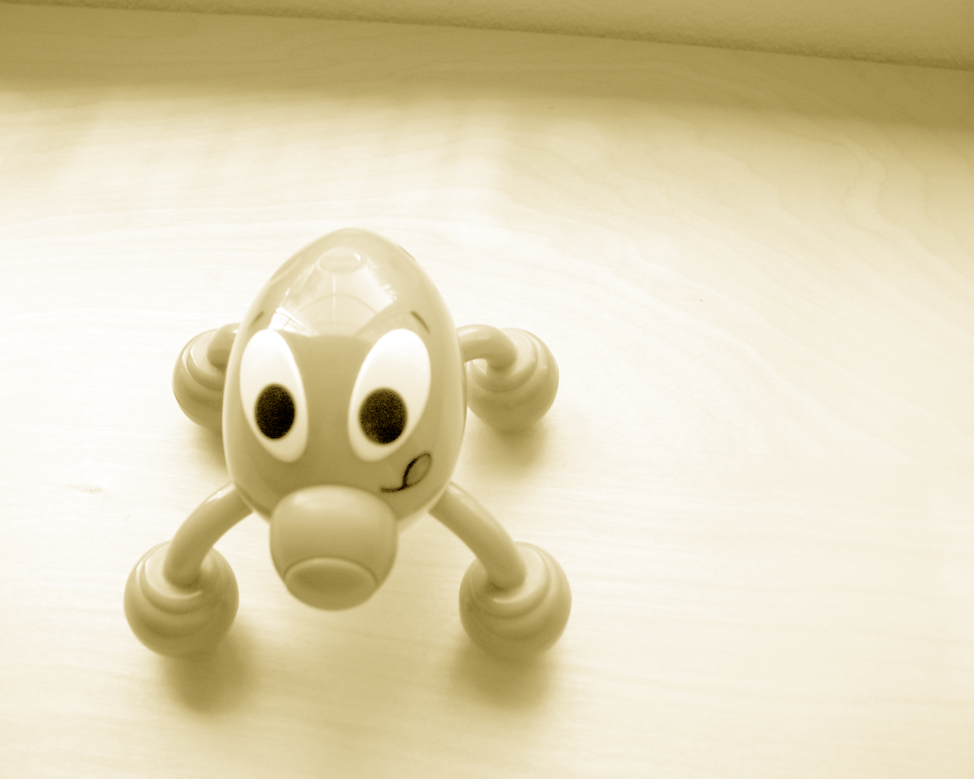
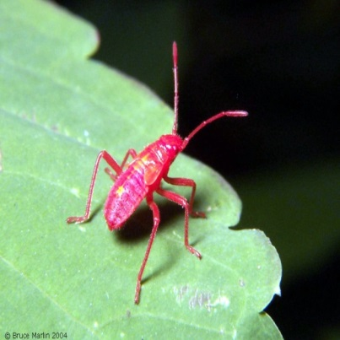
Life: Space
Life as we know it
Life as it could be
Notes:
7 7 7 7 7

Slide 8
Artificial Life
Relatively new research area in computer sciences that studies and recreates systems related to life by using computer simulations, robotics and bio chemistry
Chris Langton, 1987
Notes:
8 8 8 8 8

Slide 9
Traditional Biology: Method
Analytic
Top-down
Starts from the top (e.g. organism level) and seeks for explanations in terms of lower level entities
Notes:
9 9 9 9 9

Slide 10
Artificial Life: Method
Synthetic
Bottom up: starts at the bottom (e.g. molecular level)
It works by synthesizing complex systems from many simple local interacting entities.
Notes:
10 10 10 10 10

Slide 11
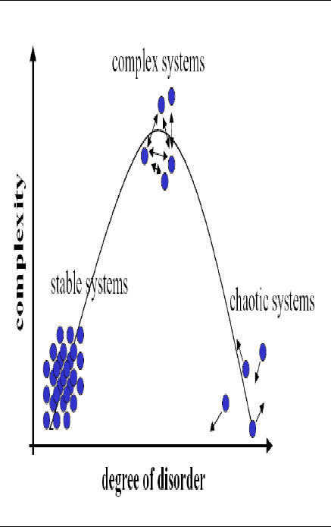
Artificial Life: Concepts
Complex Systems
Emergence and self-organization
Local rules usually defined as dynamic systems

Slide 12
Dynamic System
Evolves in time according to a set of rules
What changes in time is a variable (e.g. Position, concentration, temperature, …)
Present conditions determine the future.
Rules are usually nonlinear (e.g. set of diff. eq. Defining rates of change)
• There may be many interacting variables

Slide 13
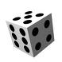

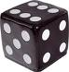
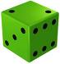
Sierpinski Triangle
Algorithm
Draw a random point
Throw a dice
Draw the middle point between the current point and the associated vertex
Go line 2
… .
1, 2
5, 6
3, 4

Slide 14
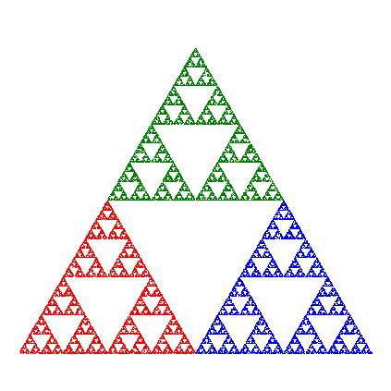
Sierpinski Triangle
Demo

Slide 15
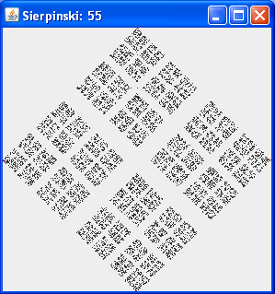
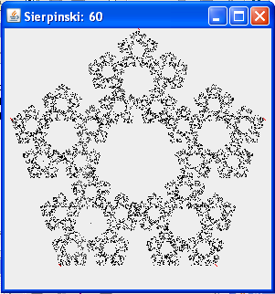
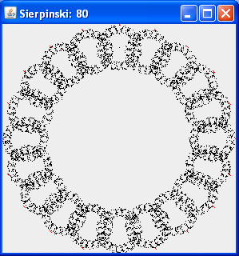
Beyond Sierpinski
Square Pentagon 20-sides

Slide 16
Rand Gravitational Clustering
Data Clustering is viewed as a dynamic system
Points change in time and group themself according to some dynamic rules
Clusters emerge from the dynamic behavior of the data points
No optimization approach

Slide 17
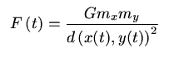
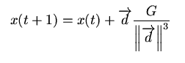
Rand Gravitational Clustering
Non hierarchical approach, Robust and Unsupervised Clustering approach
Each point is moved using the gravitational force exerted by another single object over it and Newton’s second motion law
Video

Slide 18
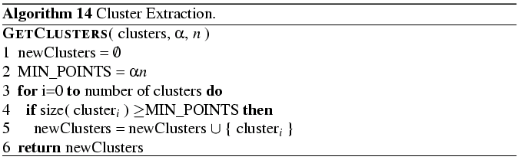
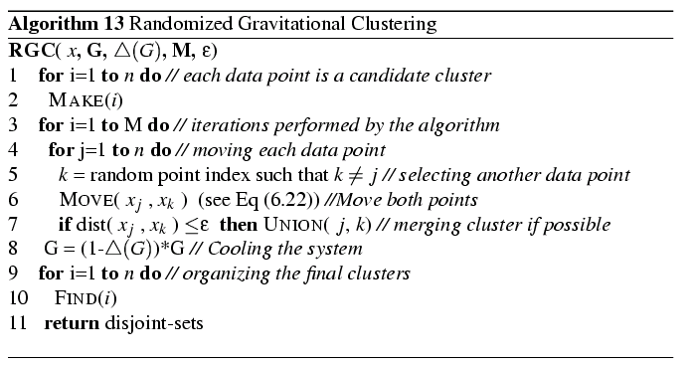
Rand Gravitational Clustering

Slide 19
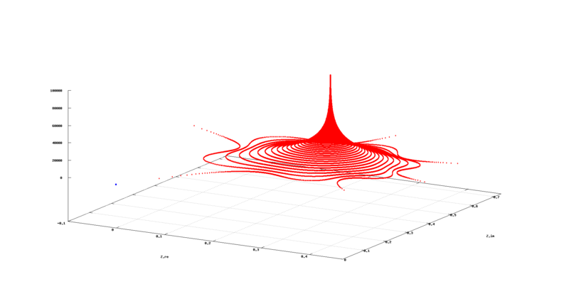
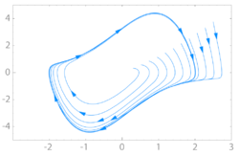

Dynamic System: Attractors
Atracctor
Fixed Point
Limit Cycle
Strange
Video

Slide 20
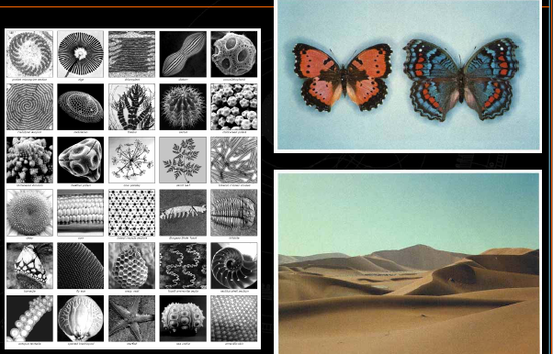
Natural Patterns
Notes:
20 20 20 20 20

Slide 21
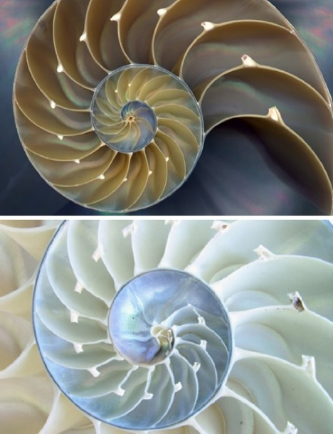
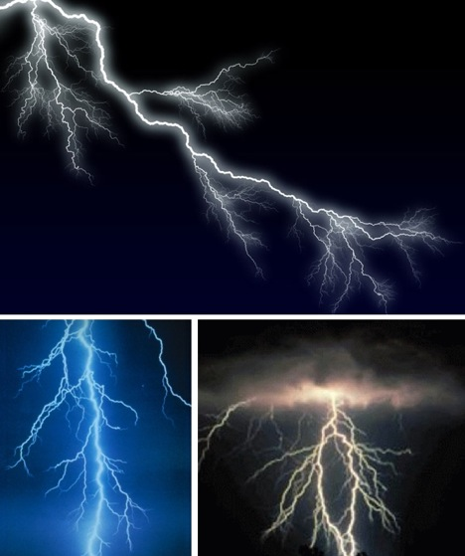
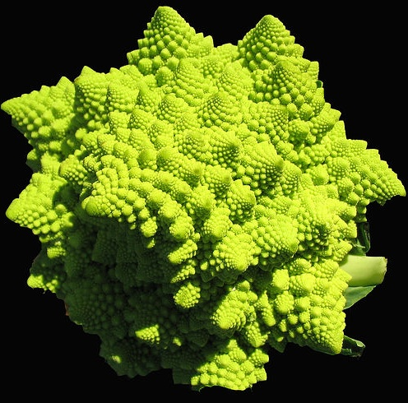
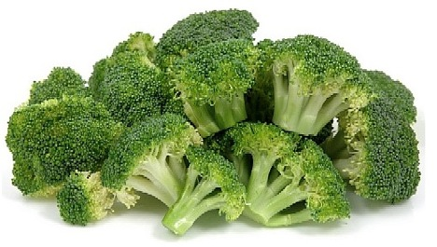
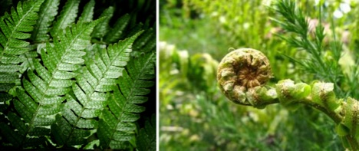
Fractals
Notes:
21 21 21 21 21

Slide 22
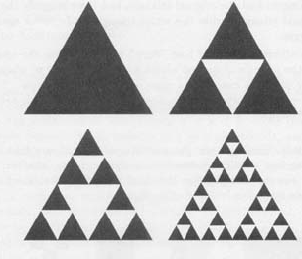
Lindenmayer Systems
Production Systems (Grammar)
Example: Replace any filled triangle (left) with the three smaller filled triangles leaving empty the center (right)

Slide 23
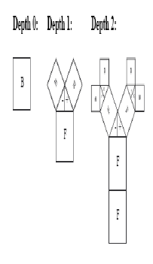
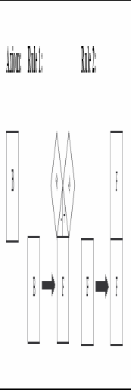
Lindenmayer Systems

Slide 24
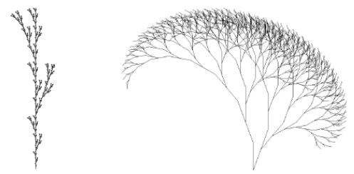
Lindenmayer Systems
Video
Notes:
24 24 24 24 24

Slide 25
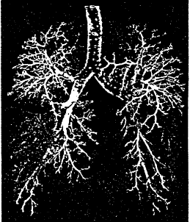
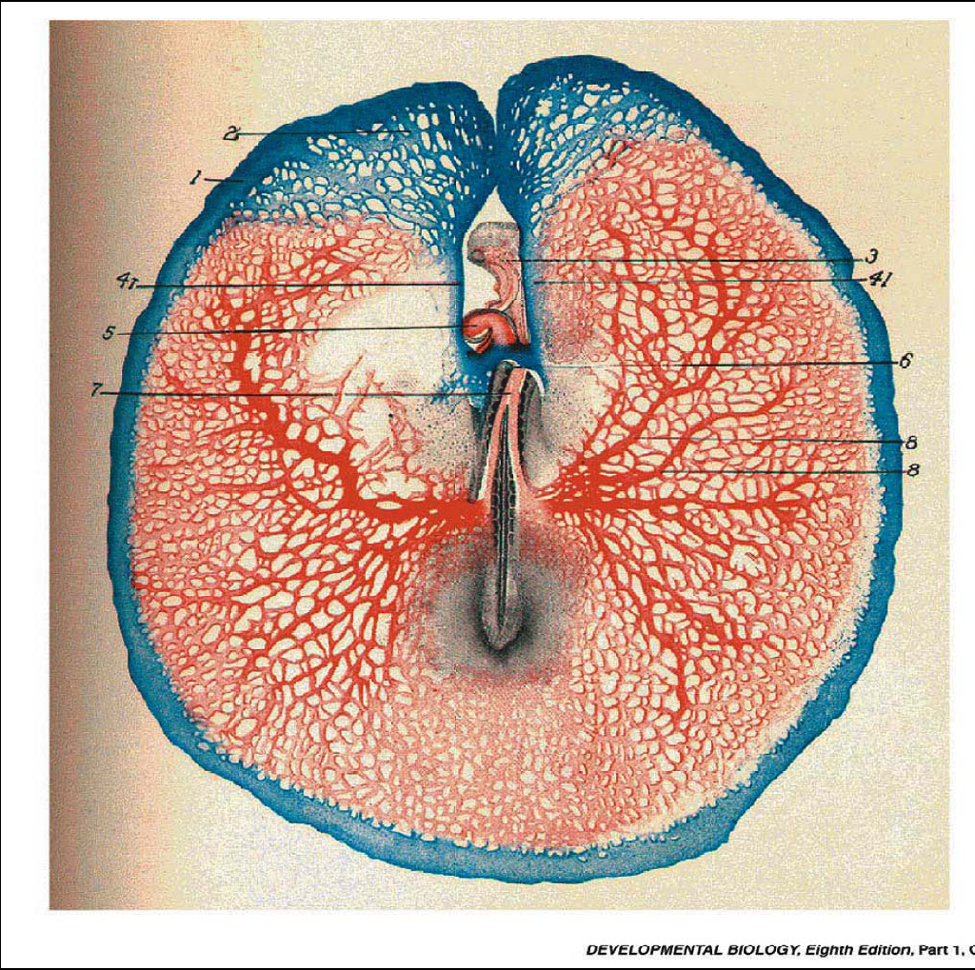
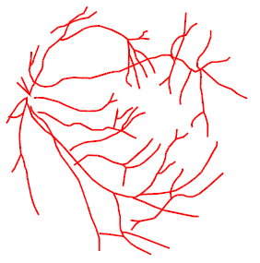
Looks like
Video

Slide 26
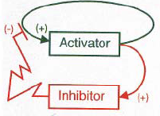
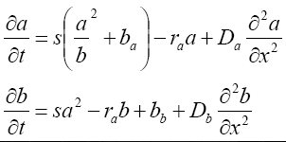
Reaction/Diffusion Systems
a(x, t), b(x, t): activator, inhibitor concentrations
s: Auto-catalysis capability of cell
Da, Db: diffusion constants
ra, rb: decay rates
ba, bb: Basic production activator/inhibitor
sa2/b: no lineal auto-catalitic influence
raa: removing rate (proportional to concentration)

Slide 27
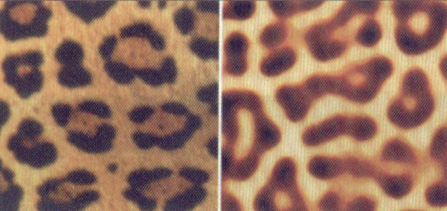
Reaction/Diffusion Systems
Cheeta motif Chemical motif
Notes:
27 27 27 27 27

Slide 28
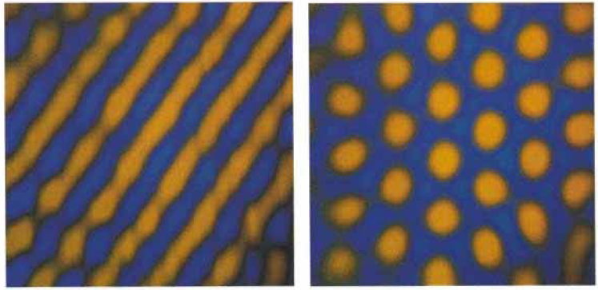
Reaction/Diffusion Systems
Motifs
Demo

Slide 29
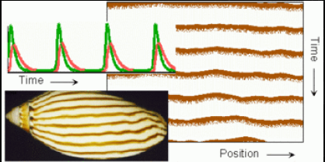
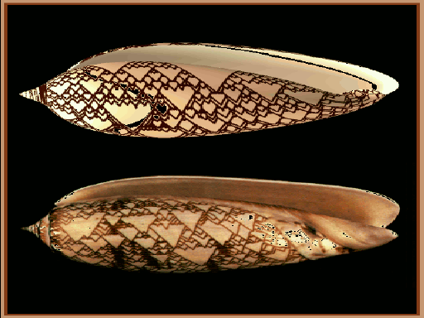
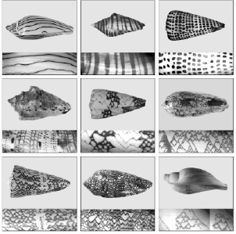
Reaction/Diffusion Systems

Slide 30
Reaction/Diffusion Systems
We are developing a virtual central nervous system growing mechanism based on reaction/difussion systems.
Each neuron locates other neurons, sensors and actuators by expanding nerve cells according to the activator/inhibitor concentrations induced by such elements.

Slide 31
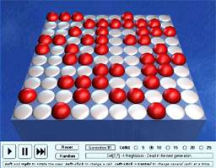
Cellular Automata
Lattice, each cell taking a finite possible set of values
Value of each cell changes in the same discrete synchronous way
Change depends only on the neighboor cells (possibly including itself)
Notes:
31 31 31 31 31

Slide 32
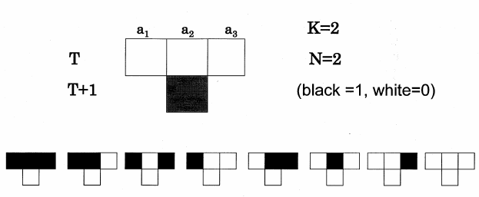
Cellular Automata
1 Dimensional

Slide 33
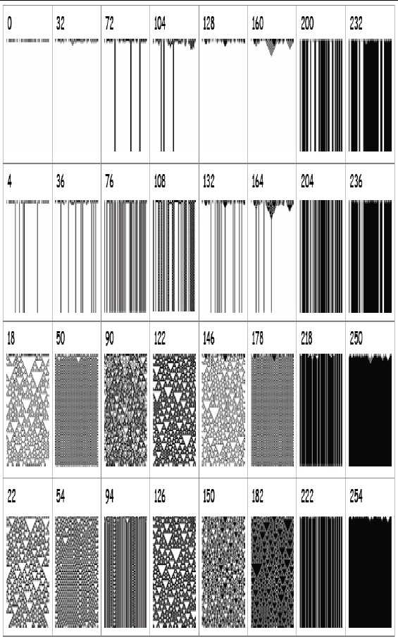
Cellular Automata
Space-time Diagram
Video

Slide 34
Game of Life
2 dimensional
Any live cell with fewer than two live neighbours dies, as if caused by underpopulation.
Any live cell with two or three live neighbours lives on to the next generation.
Any live cell with more than three live neighbours dies, as if by overpopulation.
Any dead cell with exactly three live neighbours becomes a live cell, as if by reproduction.
Demo
Notes:
34 34 34 34 34

Slide 35
Cellular Automata
We develop a Wireless Sensor Network coordination mechanism based on a non regular cellular automaton that is able to improve the performance of the WSN
We combine CA with evolutionary algorithms for inducing diversity in the EA population. We are able to simulate sort of Cambrian Explosion and Massive extinction mechanisms.

Slide 36
Cellular Automata
We define a Cellular automaton and agent concepts for simulating the life cycle of the PapillomaVirus Variant 16 and its interaction with the immune system for inducing cervical cancer.
We use an hexagonal cellular automaton for simulating the life cycle of a cell.

Slide 37
Cellular Automata
We use an hexagonal cellular automaton for simulating the horizontal transcription process (plasmid transference) in bacteria and study antibiotic resistence.

Slide 38
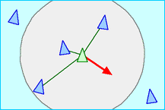
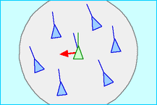
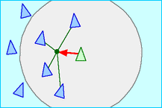
Collective Behaviour - Boids
Separation Alignment Cohesion
Video
Notes:
38 38 38 38 38

Slide 39
Collective Behaviour - Termites
Simple Units able to solve (optimization) problems
Stigma based communication (pheromone)
Video

Slide 40
Collective Behaviour - Termites
We combine ants (termites) ideas with Q-learning and Language Game theory for designing a Self failure detection and repairing mechanism (Autonomic computing)
Video

Slide 41
Collective Behaviour - Robots
We develop a simulation framework for studying collective robotics and applied it to robot-soccer.
We develop a previous version of the robot-soccers and we are developing an improved version of such robot-soccers
Video

Slide 42
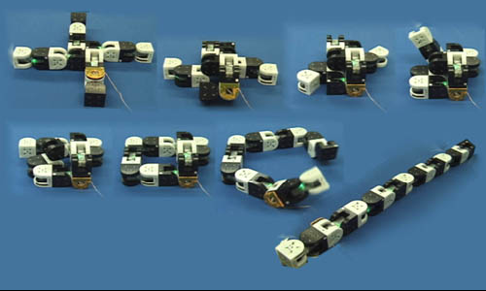
Modular Robots
Simple Cooperative Robots
Video

Slide 43
Modular Robots
We develop a Modular Robot that combines Central Pattern Generator (sinusoidal waves) with Hormone inspired communication for moving the robot in odd terrains and avoid obstacles.
Video
Video 2

Slide 44
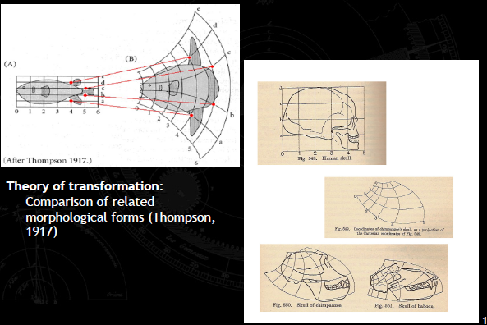
Transformation
Notes:
44 44 44 44 44

Slide 45
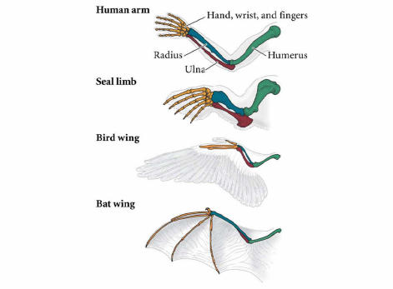
Transformation
Notes:
45 45 45 45 45

Slide 46
Bio-inspired Robots
We design a robot that uses organic waste and a colony of bacteria as source of energy
We are developing a mini-robot that uses vibration for moving and such organic waste and colony of bacteria as source of energy
Video

Slide 47
Evolution: Darwin Pond
Designed by Jeffrey Ventrella (1996)
Simulation of “swimmers”
Evolving behaviors and form
Phenotype is defined by color, age, legs
Purpose of swimmers: Eat and Sex
Notes:
47 47 47 47 47

Slide 48
Evolution: Darwin Pond
Notes:
48 48 48 48 48

Slide 49
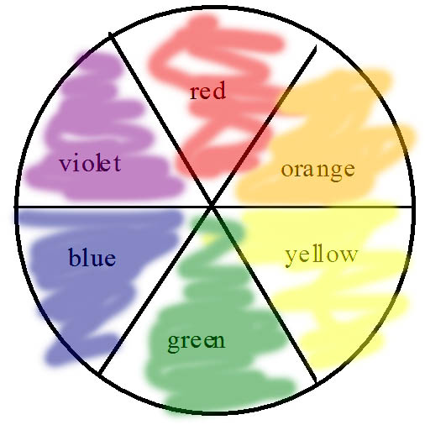
Evolution: Darwin Pond
Notes:
49 49 49 49 49

Slide 50
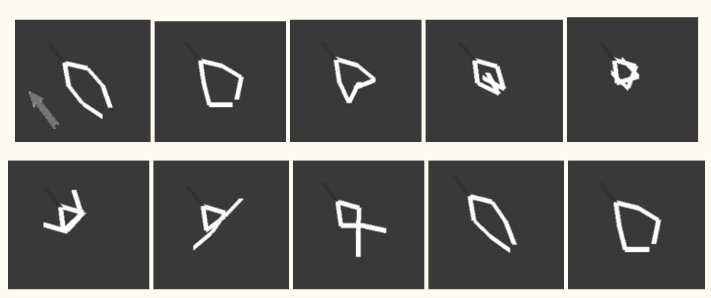
Evolution: Darwin Pond
Video
Notes:
50 50 50 50 50

Slide 51
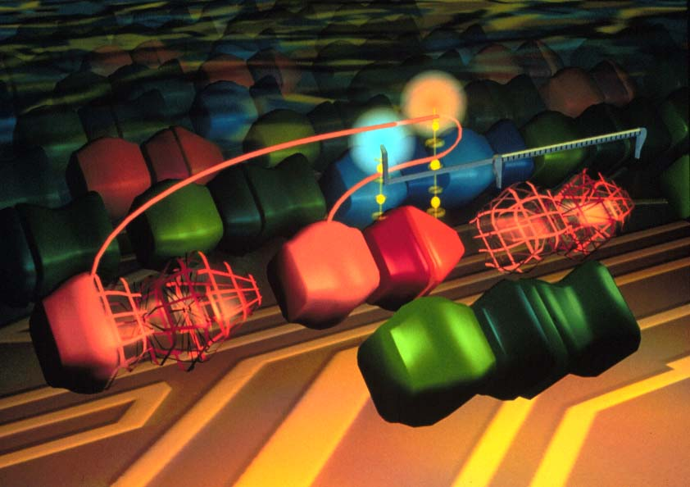
Tierra
Haga clic para modificar el estilo de texto del patrón
Segundo nivel
Tercer nivel
Cuarto nivel
Quinto nivel
Notes:
51 51 51 51 51

Slide 52
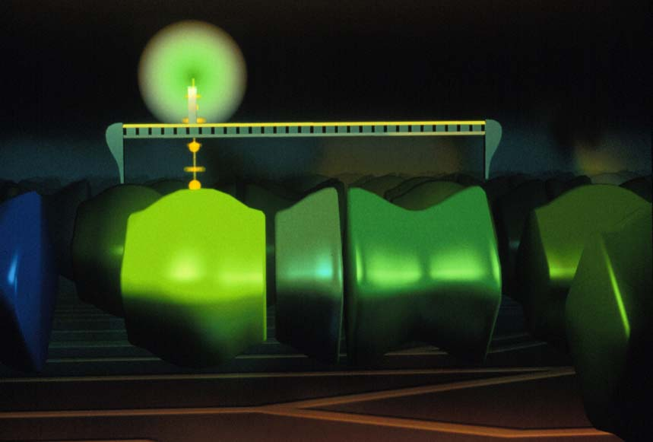
Tierra: Life
Notes:
52 52 52 52 52

Slide 53

Tierra: Mutation and Death
Notes:
53 53 53 53 53

Slide 54

Tierra: Parasite
Notes:
54 54 54 54 54

Slide 55

Notes:
55 55 55 55 55

Slide 56

Notes:
56 56 56 56 56

Slide 57

Notes:
57 57 57 57 57

Slide 58
Evolution
We design a new evolutionary algorithm that uses chaotic behaviour for adapting the probability of applying the genetic operators
We develop a system that uses such EA and fuctional rewitting concepts for inducing functional programs
Notes:
58 58 58 58 58

Slide 59
Evolution
We are using such EA for obtaining near optimal solutions to optimization problems like Two Steps Distribution Chain Problem, The Quadratic Assignment Problem
We use it for studying the prisoner dilemma and some other related theory of games problems.
Notes:
59 59 59 59 59

Slide 60
Evolution
We are extending such EA not for just adjusting the probabilities but for evolving the genetic operators (Meta-evolution)
We are combining EA with neural networks for solving general artificial intelligence problems
Notes:
60 60 60 60 60

Slide 61

God and Alife
Video
Notes:
61 61 61 61 61

